Slide 1
Side Channel Attacks Against the Arduino Uno Owen Lo Edinburgh Napier University

Slide 2
Presentation Outline
Introduction to Side Channel Attacks
Timing Attack Demo
SPA/DPA/CPA Power Analysis Overview
DPA/CPA attacks against the AES-128 S-Box on an Arduino Uno

Slide 3
Side Channel Attacks
Side Channel Monitoring
Power
Heat
Time
Sound
Plaintext
Message
Cryptographic Function
Encrypted
Message
Secret Key
A side channel attack is carried out by monitoring the physical outputs of a device (e.g. power consumption, time taken to carry out an operation, emission of heat, light and sound).

Slide 4
Timing Attacks
In which we analyse the time taken for a system to execute certain tasks (e.g. encryption, decryption or password entry) to reveal information leakage.

Slide 5
Timing Attacks (Demo)
Removed due to large file size. The mp4 video can be downloaded from:
https://www.dropbox.com/s/906p8pwt0ksp8kk/timingattack.mp4?dl=0
Source Code based on: http://eax64.github.io/2015/04/10/timing-attack-on-arduino.html

Slide 6
Timing Attack - How did it work?
The timing attack shown works due to this code within the ‘pin entry system’:
int check(char *input)
{
int i;
for (i = 0 ; i < 4 ; i++)
if (input[i] != password[i])
return 0;
return 1;
}
Each character in the input is verified consecutively leading this code to be vulnerable to timing attacks.

Slide 7
Power Analysis
Correlate the level of power consumption to operations of the device under attack.

Slide 8
Categories of Power Analysis Attacks
Three Main Categories:
Simple Power Analysis (SPA)
Differential Power Analysis (DPA)
Correlation Power Analysis (CPA)

Slide 9
Simple Power Analysis (SPA)
Visual Interpretation of power traces.
1 2 3 4 5 6 7 8 9 10
10 Rounds of AES-128

Slide 10
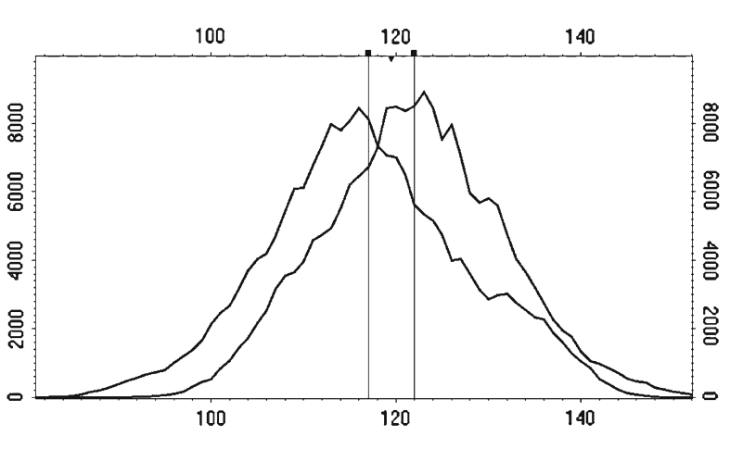
Differential Power Analysis (DPA)
Detect small variations in power traces based on output of cryptographic operations.
Example: output 1101 vs 1100 will produce different power consumption levels.
LSB 1
LSB 0
Source: P. Kocher, J. Jaffe, B. Jun, and P. Rohatgi, “Introduction to differential power analysis,” J. Cryptogr. Eng., vol. 1, no. 1, pp. 5–27, 2011.

Slide 11
Correlation Power Analysis (CPA)
Correlate actual power traces against hypothesised power model.
Example: for secret key guess 65, can compare our hypothesised power model against the actual power result:

Slide 12
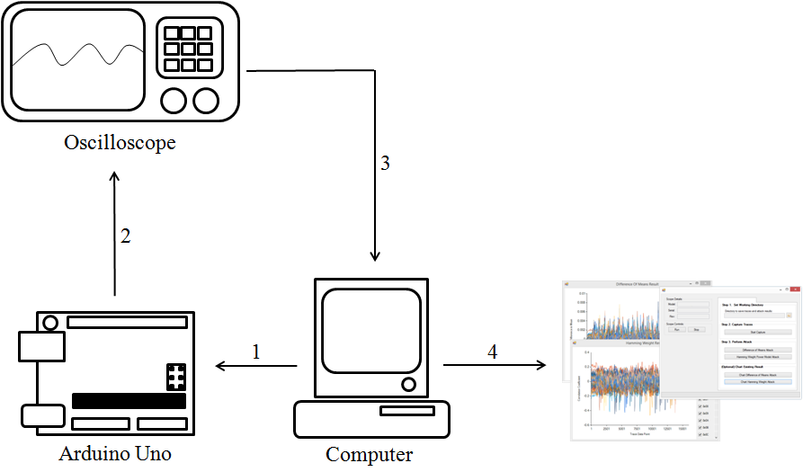
Attacking the AES-128 S-Box running on an Arduino Uno
The experimental setup used for attacking AES-128 is shown below:

Slide 13
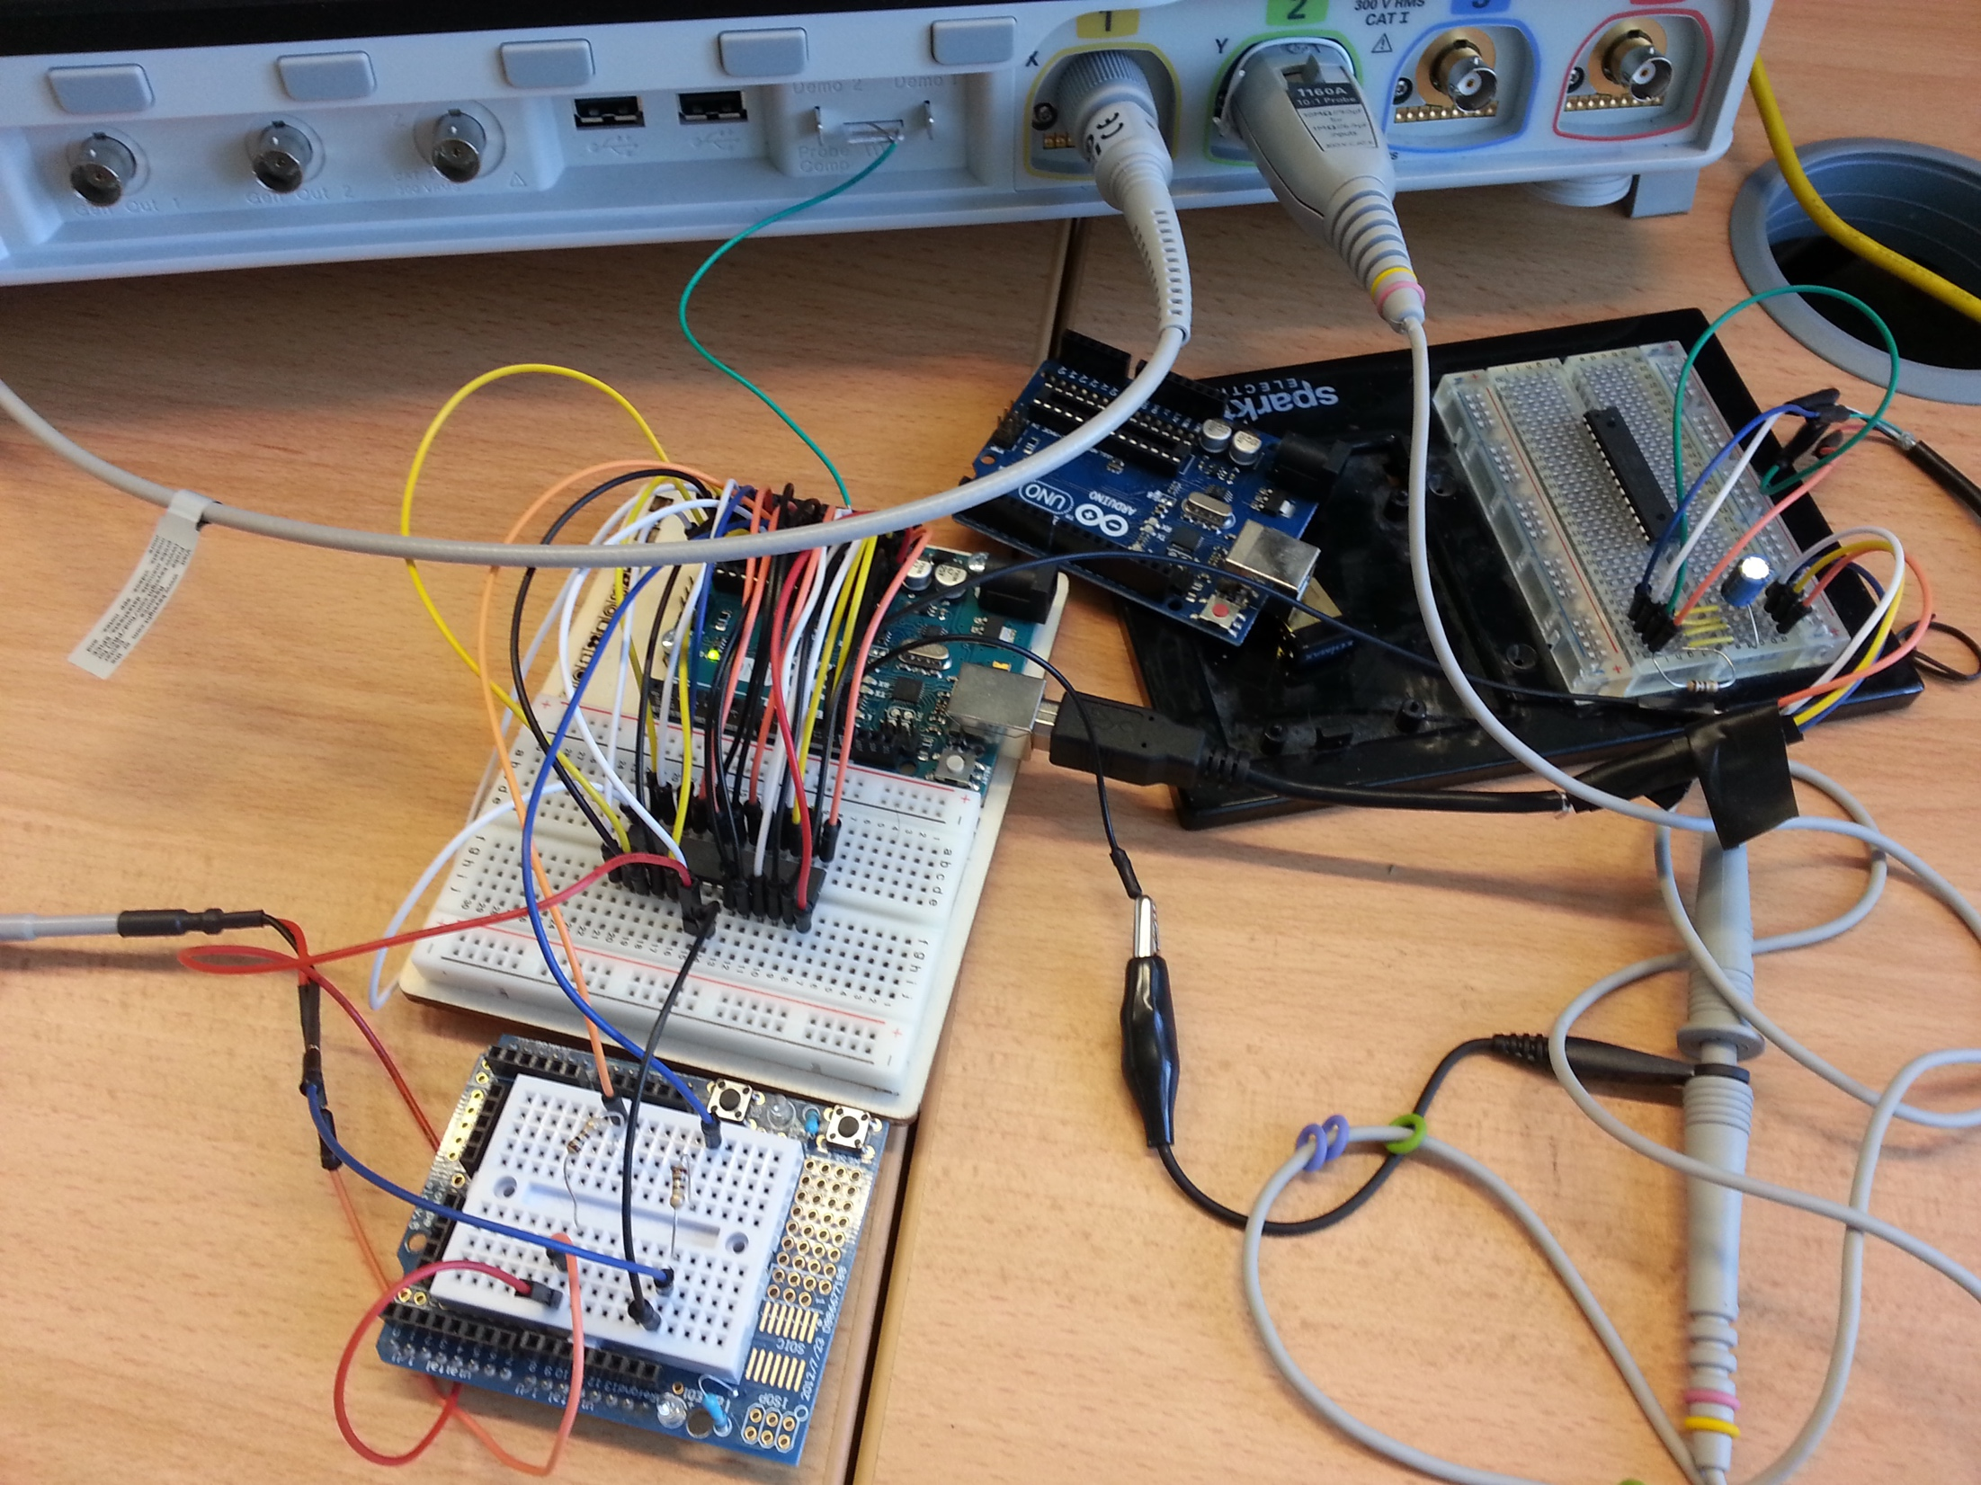
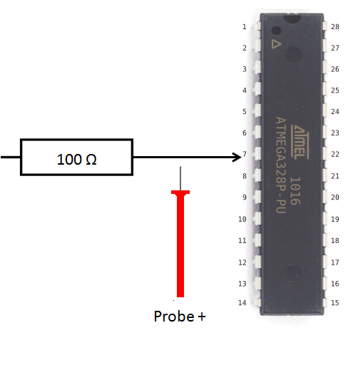
Photo of Probe Setup

Slide 14
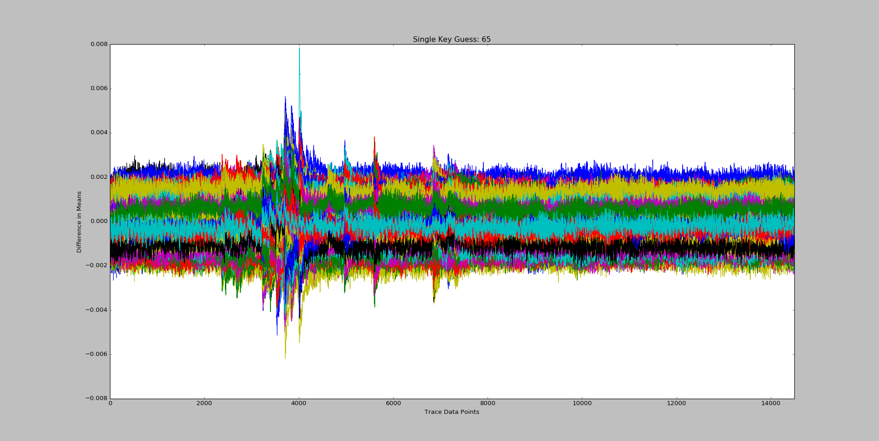
1-Byte Cipher Key Result using DPA (AES-128)

Slide 15
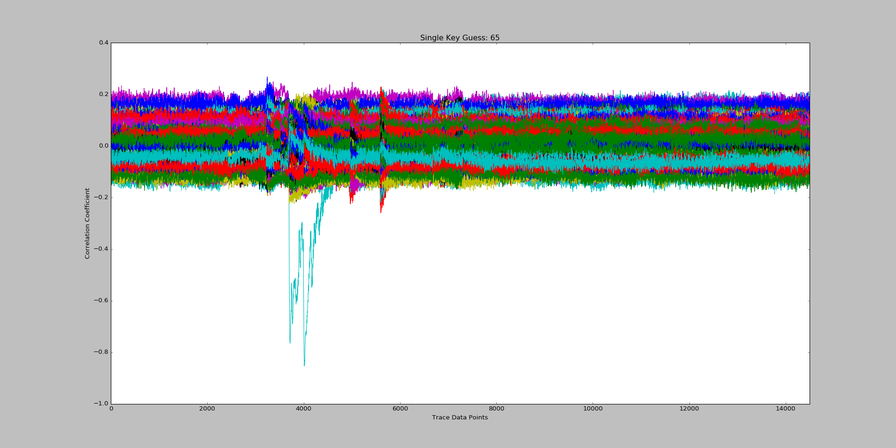
1-Byte Cipher Key Result using CPA (AES-128)

Slide 16
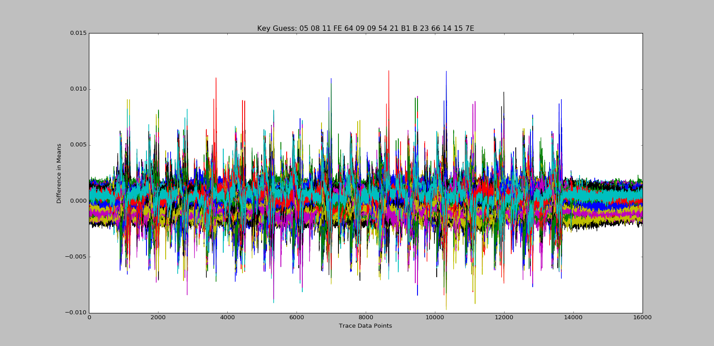
16-Byte Cipher Key Result using DPA (AES-128)

Slide 17
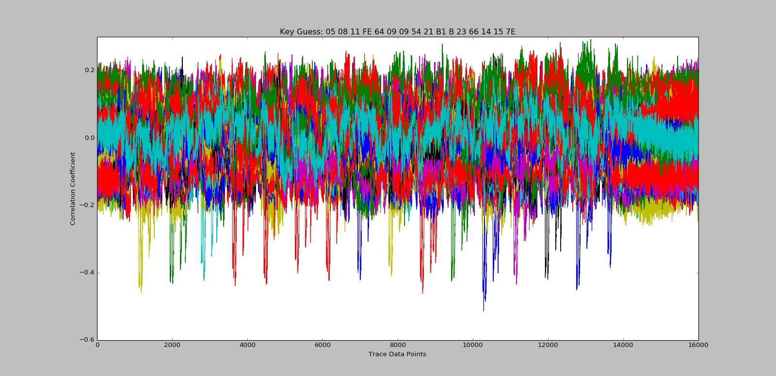
16-Byte Cipher Key Result using CPA (AES-128)

Slide 18
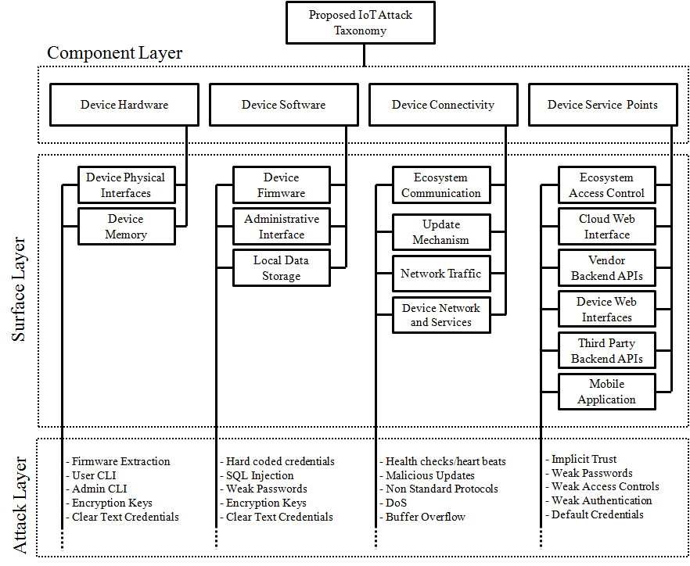
Current Work (in progress)
Building the work of OWASP, GSMA and others,
we wish to investigate the possibility of producing a
methodology to enable us to evaluate how ‘secure’
an IoT device is.

Slide 19
References
O. Lo, W.J. Buchanan, D Carson, “Power Analysis Attacks on the AES-128 S-box using DPA and CPA”, J. Cyber Security Technology, 2016.
Kocher P, Jaffe J, Jun B. Differential power analysis. In: Wiener M, editor. Advances in cryptology - CRYPTO’ 99: 19th annual international cryptology conference; Aug 15–19; Santa Barbara (CA). Berlin: Springer; 1999. p. 388–397.
Zhou Y, Feng D. Side-channel attacks: ten years after its publication and the impacts on cryptographic module security testing [Internet]. Cryptology ePrint archive. 2005 [cited 2016 Sep 6]. Available from: https://eprint.iacr.org/2005/388.pdf
Brier E, Clavier C, Olivier F. Correlation power analysis with a leakage model. Cryptogr Hardw Embed Syst. 2004;3156:16–29.
Pub NF. 197: advanced encryption standard (AES). Fed Inf Process Stand Publ. 2001;197:441– 311.
http://eax64.github.io/2015/04/10/timing-attack-on-arduino.html

