Slide 1
Agency and transparency in publically deployed IoT systems
Naomi Jacobs, Peter Edwards, Caitlin Cottrill and Karen Salt
University of Aberdeen, University of Nottingham

Slide 2
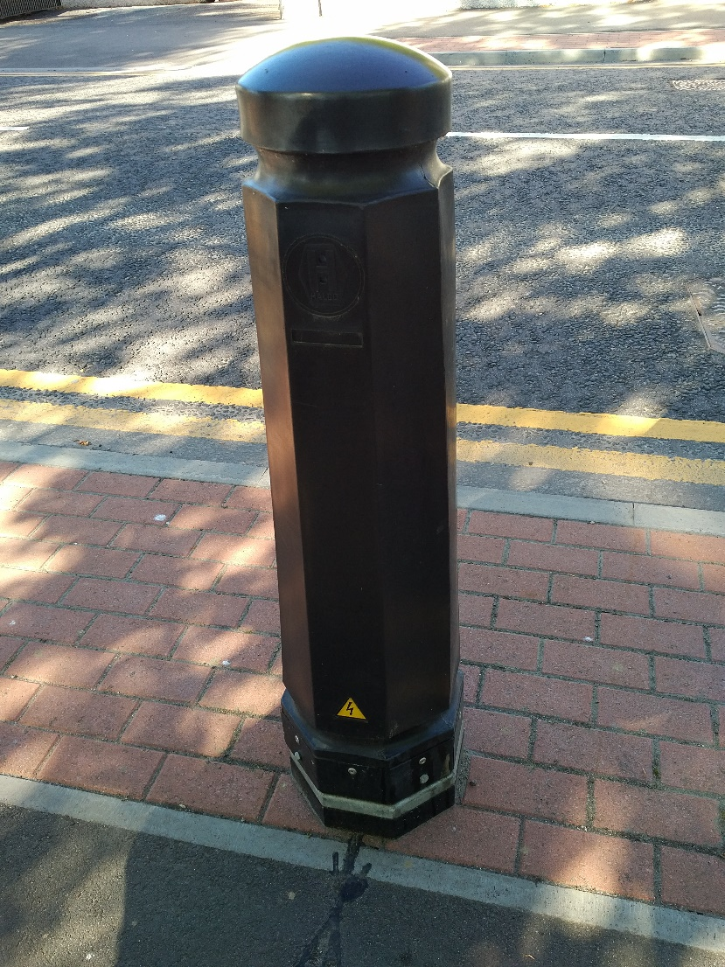
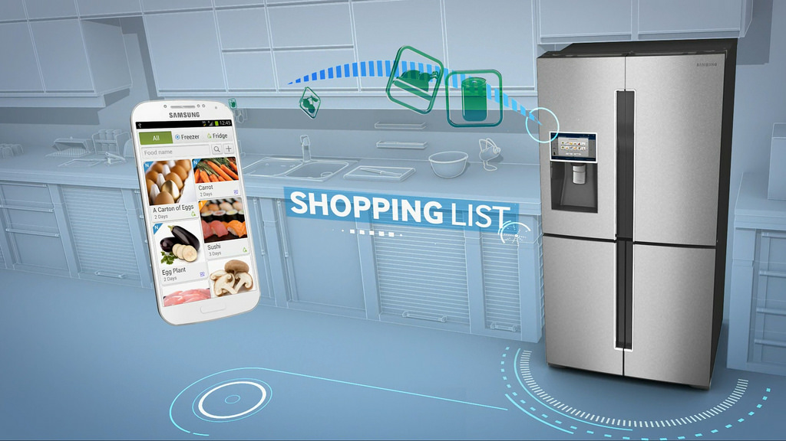
Internet of Things and the Smart City

Slide 3
Origins of community based IoT deployments
Groups of individuals

Slide 4
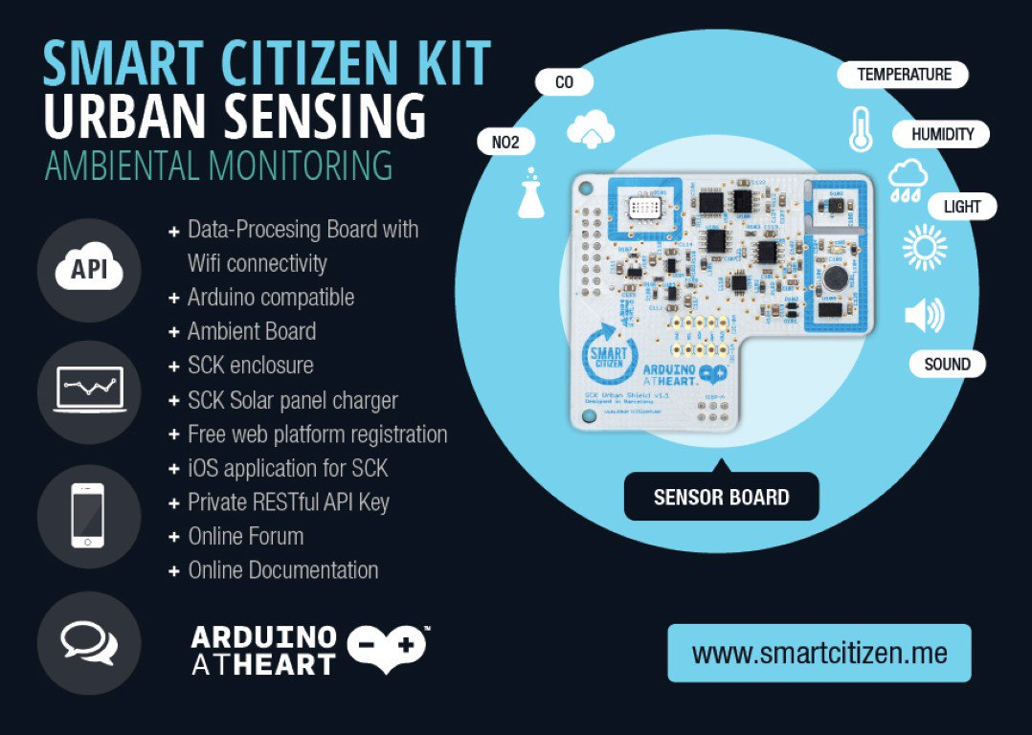
Origins of community based IoT deployments
Groups of individuals
Barcelona – Citizen science initiatives

Slide 5
Origins of community based IoT deployments
Groups of individuals
Research and pilot projects

Slide 6
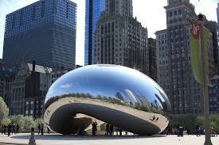
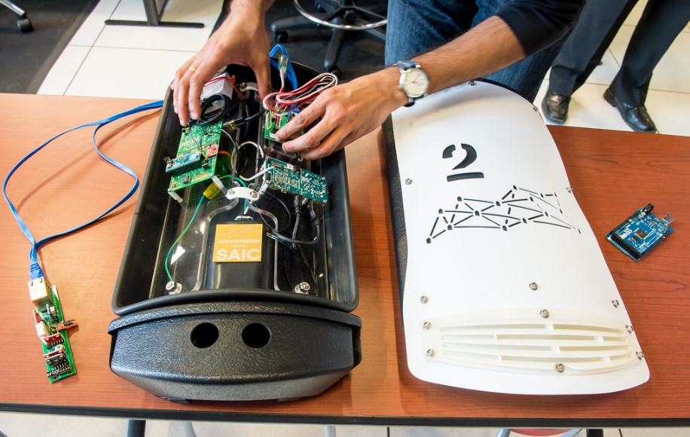
Origins of community based IoT deployments
Groups of individuals
Research and pilot projects
Chicago Array of Things

Slide 7
Origins of community based IoT deployments
Groups of individuals
Research and pilot projects
Public bodies – government and councils

Slide 8
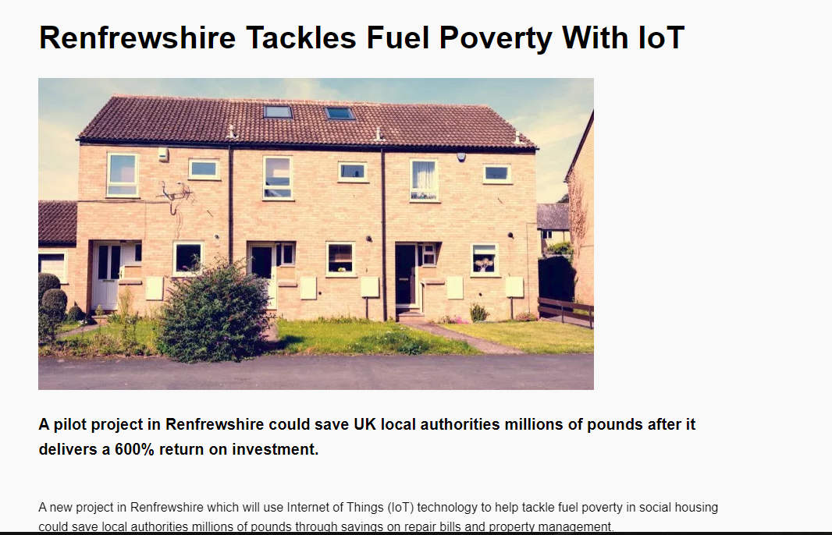
Origins of community based IoT deployments
Groups of individuals
Research and pilot projects
Public bodies – government and councils
Renfrewshire council – sensor equipped social housing
“The pilot, which has been running since July 2016 captures real-time data on temperature, humidity and carbon dioxide levels at 50 homes, whose residents have opted into the programme, including terraced housing, high rises and cottages around Paisley.
The data allows the local authority to identify anomalies in housing and take preventative action to protect both tenants and property. Data which shows consistent high humidity and low temperatures could, for example, indicate a tenant is living in fuel poverty, while high carbon dioxide levels could show a problem with ventilation and air quality.”

Slide 9
Risks for citizens
Impact on privacy?
Cybersecurity implications
Lack of agency
Lack of transparency
Unconsidered outcomes

Slide 10
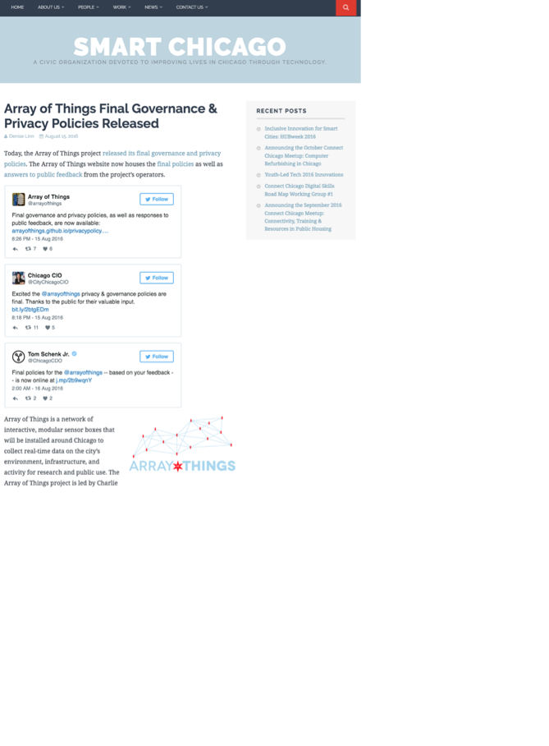
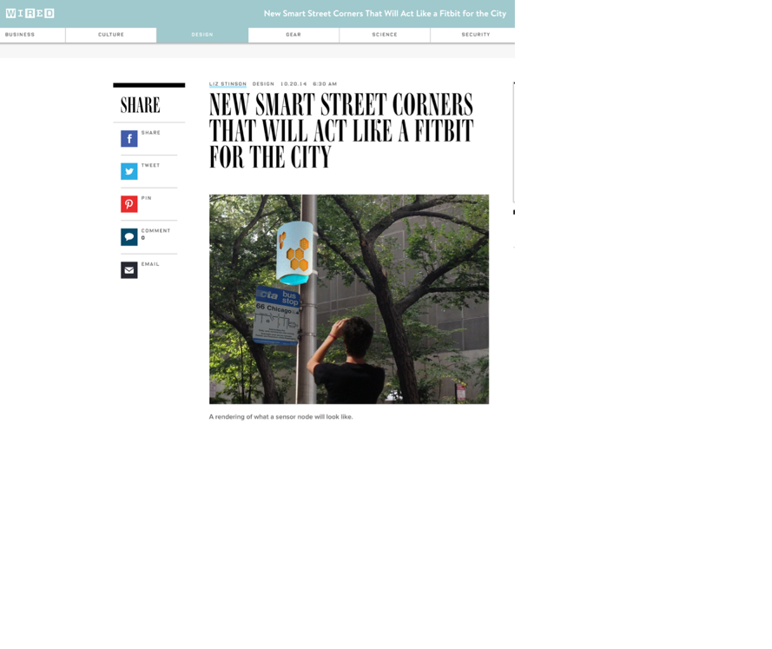
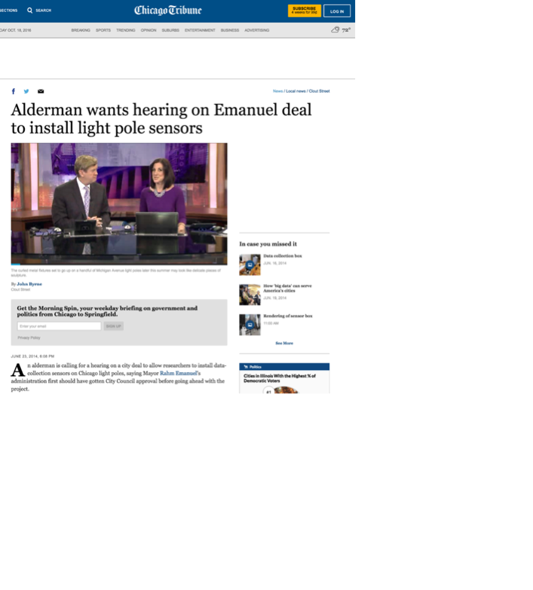
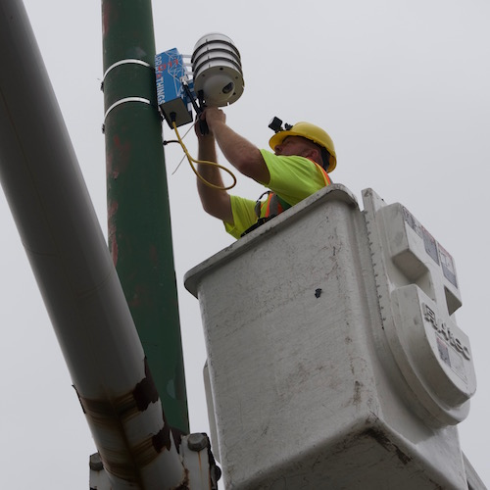
2014
2014
AUG 2016
Notes:
AoT will deploy 500 nodes across the city by the end of 2018. The city held two public forums and solicited feedback online from residents before releasing a final policy this week – but still issues !

Slide 11
Levels of governance
From ‘The Internet of Things 2012 New Horizons’ Ed. Smith.

Slide 12
Top-down governance
Fast moving technology requires fast adapting governance
Who benefits? (commercial standards/government standards)
Impacts on citizens
Different actors: governments, agencies, organisations

Slide 13
Top-down policies:
Highlight importance of trust, privacy and security
Include regulation and ethical standards to prevent exploitation of the public
Impacted by data privacy legislation
Focus on standards and regulation, e.g. British Standards Institute documentation
May provide funding packages to encourage local innovation and infrastructure, e.g. IoTUK
May focus on private sector leadership supported by national policy (e.g. US Policy)

Slide 14
Bottom-up governance
May not have been fully considered if projects are distributed and grass-roots
May not be more widely applicable if projects are small scale
May not be more widely applied if learning is not communicated effectively
Needs to be embedded at start of projects and be inclusive

Slide 15
Tillydrone
Area of Aberdeen
Scores highly on Scottish Index of Multiple Deprivation
Many interventions, programmes and activities – from different actors including the community

Slide 16
TrustLens in Tillydrone
Ethnographic work with the community
Interviews – what issues are important?
Identification of current and imminent IoT examples

Slide 17
Notes:
WHO WHAT WHEN WHY WHERE WHICH W(HOW)

Slide 18
What risks are associated with the data?
Who installed this device?
Where are the data sent?
Why was it installed?
How are the data used?
What sensors are deployed?
What controls (if any) do I have?
What data does it generate?
Notes:
WHO WHAT WHEN WHY WHERE WHICH W(HOW)
Is it monitoring people on the road? Cars? How can it measure cars without a camera, and does this mean it has one?
Who has access to the data, and can we have it too?
Community Council previously asked Planning and Transport department if they could have access to data, were told it was being collated – this means it is measuring something and data does exist
How are the council getting traffic statistics? Is it accurate?

Slide 19
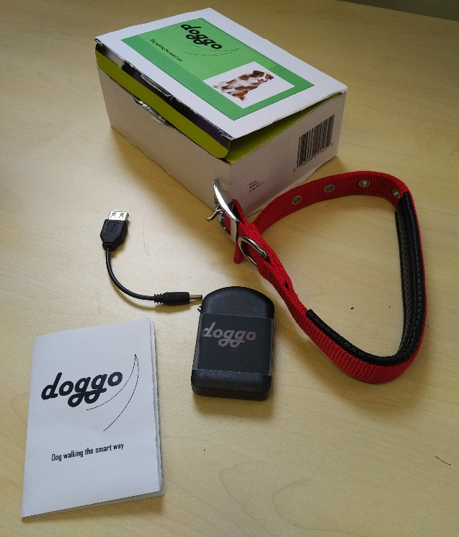
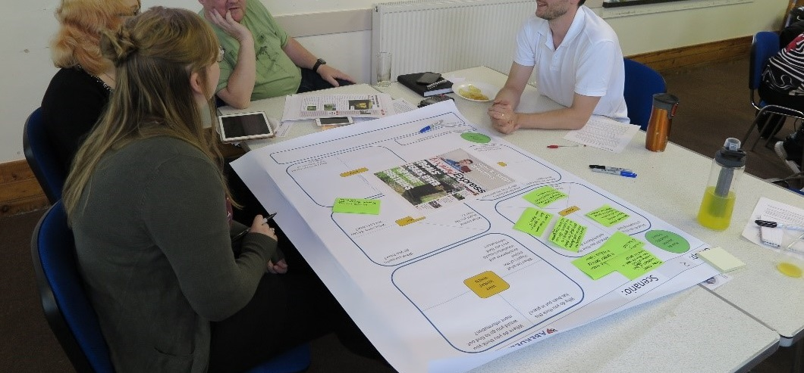
TrustLens in Tillydrone
Design fictions developed based on community interests
Workshop activities to explore questions including transparency and governance

Slide 20
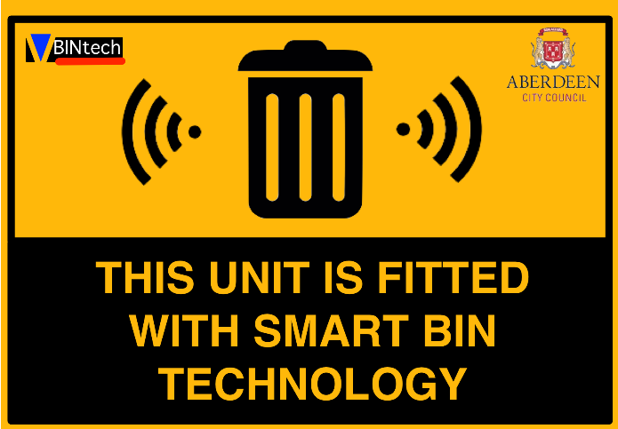
Internet of Things in the Smart City
Individual agency: Do I get to choose what IoT I interact with? Where it is installed?
How does it all come together in the background (and why should I care?)
Public sector deployments impact citizens

Slide 21
Supporting citizens in IoT deployments
Consultation and inclusion
Transparency of governance
Transparency of technology
Closing the governance gap

Slide 22
How to Realise Trusted Things?
What does it mean to deliver IoT solutions that are trusted by users and communities?
Transparent
Accountable
Technology integrated with governance
What are the appropriate governance and policy arrangements to frame future IoT deployments?
Maintained at all levels of governance
Consistent with national policy
Inclusion of citizen-led activism

Slide 23
IoT for the benefit of the citizen
Integrated governance
Transparent and accountable systems

