Slide 1
A Community Driven Transparency Model for the IoT
David Corsar
TrustLens Project Team
Aberdeen: Pete Edwards, Caitlin Cottrill, Naomi Jacobs, Milan Markovic
City: Raj Muttukrishnan, Waqar Asif
Nottingham: Karen Salt

Slide 2
Transparency in TrustLens
Background
“Presenting individuals with understandable and relevant information on how their data is being acquired and used, and the associated risks and benefits.”

Slide 3
Developing a Transparency Model for the IoT
Model Specification
Purpose
Capture the information necessary to support mechanisms for increasing transparency and accountability in a user-centred IoT ecosystem
Scope
Deployments of IoT devices, device behaviors, data, its use, …
Intended uses within TrustLens
Transparency through provision of information to individuals
Support individuals assessing the veracity of sensor data
Support users to evaluate privacy risks associated with a device, and set privacy levels for different attributes across multiples services

Slide 4
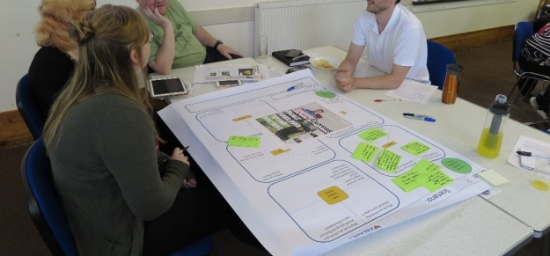
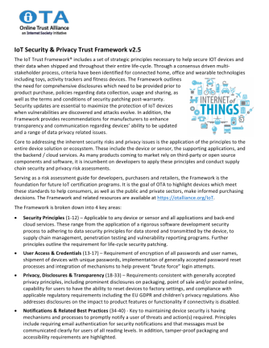
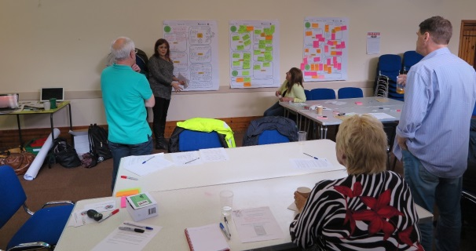
Transparency Requirements
Model Specification
From tech industry
From users

Slide 5
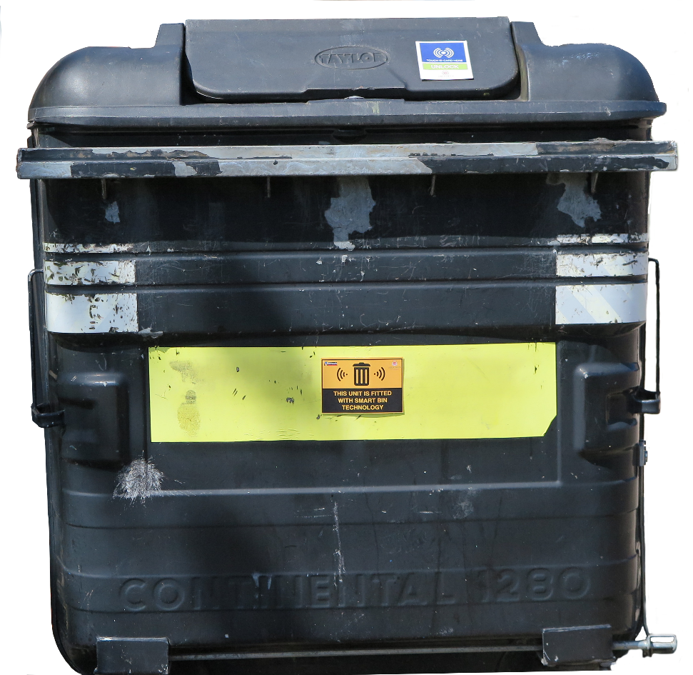
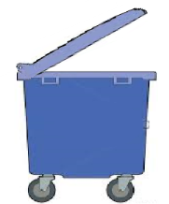
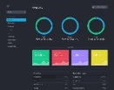
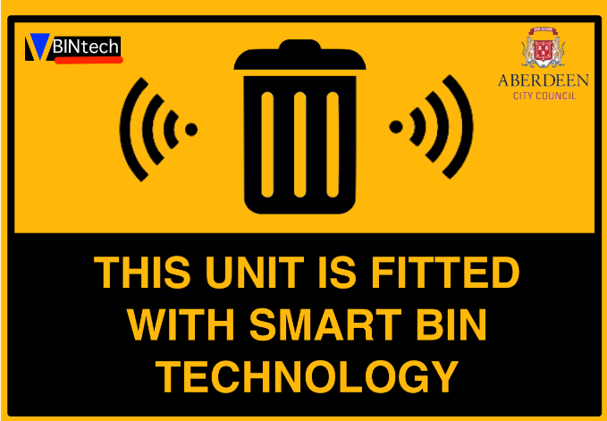
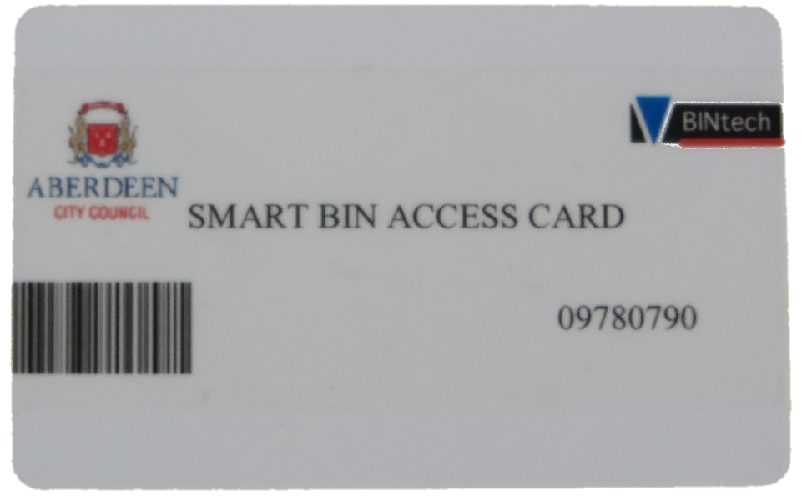
Smart Communal Waste - Ecosystem
Model Specification
2.
3.
Pinacl Free Wifi Service
Router
1.
(network infrastructure)
6.
BinTech Ltd
4.
Access cards allocated to individuals/by building
Data dashboard: maintenance team
City Council
Data ownership
Access rights
Event based alert system
5.

Slide 6
Dimensions of Transparency
Model Specification
Data Collection
Use of Data
Sharing of Data
Data Storage
The System
Sensing Capabilities
Deployment of the System
Governance

Slide 7
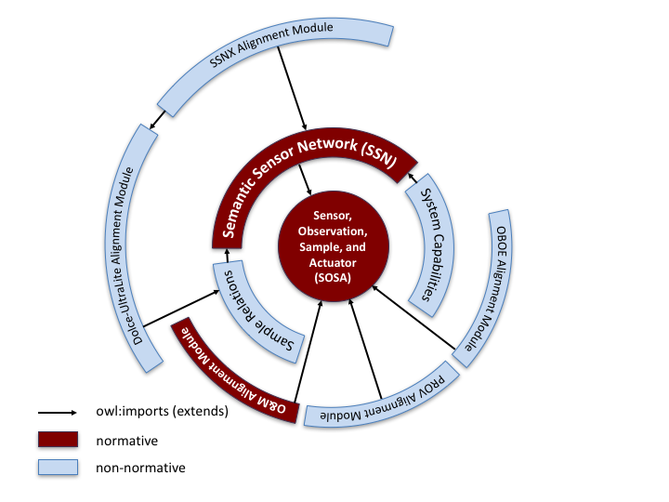
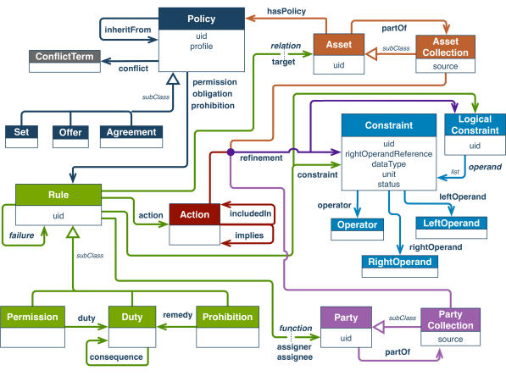
Existing Ontology Standards
Realisation
W3C & OCG Sensor, Observation, Sample, and Actuator (SOSA) and Semantic Sensor Network (SSN)
W3C PROV for interchange of provenance information on the web
W3C Open Digital Rights Language for policies

Slide 8
Describing the Communal Waste Bin System
Realisation
System
subclass of
subclass of
Communal Waste Monitor
Sensor
Actuator
has subsystem
Smoke Detector
subclass of
Ultrasonic Distance Sensor
NFC Card Reader
Electromechanical Lock
subclass of

Slide 9
Describing a Communal Waste Bin
Realisation
Communal Waste Monitor, System
cwm_1
has subsystem
Smoke Detector, Sensor
cwm_1_sd
Ultrasonic Distance Sensor, Sensor
cwm_1_usd
NFC Card Reader, Sensor
cwm_1_nfccr
Electromechanical Lock, Actuator
cwm_1_el

Slide 10
Describing Sensor and System Deployments
Realisation
Platform
bin_1_lid
is hosted by
Ultrasonic Distance Sensor
cwm_1_uds
has
deployment
Deployment
bin_1_monitoring

Slide 11
Describing Sensor Capabilities
Realisation
Accuracy
uds_accuracy
Ultrasonic Distance Sensor
cwm_1_uds
has system capability
System Capability
uds_accuracy_cap
value: 0.1
units: millimeter
observes
for property
Frequency
uds_frequency
Observable Property,
Bin Fill Level
bin_1_fill_level
System Capability
uds_freq_cap
value: 1
units: millisecond
for property

Slide 12
“How does it know the bin is full? Sensor or smell detector?”
Realisation
Transparency Model Query (English): “Which subsystem(s) of a communal waste monitor is capable of observing the fill level in deployment bin_1_monitoring”
Result
Ultrasonic Distance Sensor
cwm_1_uds
Transparency Model Query (SPARQL)
SELECT ?system WHERE {
?system a ssn:System;
ssn:hasDeployment :bin_1_monitoring
sosa:observes/rdfs:type tl:BinFillLevel.
}

Slide 13
“I would like to know what data is being collected”
Realisation
Platform
bin_1_lid
is hosted by
Ultrasonic Distance Sensor
cwm_1_uds
observes
made observation
has feature of interest
Observation
bin_1_fill_obs_1
result time: 20170802T11:41:00
Feature Of Interest
bin_1
observed property
Observable Property, Bin Fill Level bin_1_fill_level
has result
Result
value: 25 units: Percent

Slide 14
Limitations
Realisation
Captures what the system can do, not what it is actually doing
Limited deployment description
Does not capture how data are used
Not concerned with control

Slide 15
“What is the system doing?”
Realisation
has deployment,
Ultrasonic Distance Sensor, Agent
cwm_1_uds
Role
Sensor Performing Sensing
was associated
with
agent
Deployment, Activity
bin_1_monitoring
had role
Association
qualified
association
Plan,
Observe Every Minute
…
had plan

Slide 16
“Was a community consultation carried out when making decisions about it?”
Realisation
Communal Waste Monitor, Entity
cwm_1
Agent
Joe
acting on behalf of: Bintech
had role: System Installer
Activity
used
subclass of
Deployment, Activity
bin_1_monitoring
Deployment Related Activity
was associated with
Deployment Related Activity
cwm_1_bin_1_installation
was informed by
was informed by
Agent
Aberdeen City Council
Deployment Related Activity
smart_bin_rollout
was associated with

Slide 17
“How are the data used?”
Realisation
Observation, Activity
bin_1_fill_obs_1
result time: 20170802T11:41:00
Entity
in_1_fill_result_1_copy
value: 25, units: Percent
at location: server.bintech.com
used
Data Storage, Activity
data_storage_876876
was generated by
was generated by
wasGeneratedBy
was generated by
Result, Entity
in_123_fill_result_1
value: 25
units: Percent
Entity
in_1_fill_result_1_in_store
value: 25,units: Percent
at location: database.bintech.com
wasGeneratedBy
Entity
graph.png
used
used
Data Transfer, Activity
data_transfer_20170802T1142
Dashboard Graph Building, Activity
graph_build_315
was generated by
wasGeneratedBy
Agent
Pinnacle
had role: Data_Comms_Provider
Agent
John
had role: Dashboard_User
was associated with
was associated with

Slide 18
“How are the data used?”
Realisation
Transparency Model Query (English)
“Show me all activities that have used data generated by the system, or data derived from that data”
Transparency Model Query (SPARQL)
SELECT ?activity WHERE {
:cwm_1 ssn:hasSubSystem ?sensor.
?result prov:wasGeneratedBy/prov:wasAssociatedWith ?sensor.
?e (prov:wasGeneratedBy/prov:used)+ ?result.
?e prov:wasGeneratedBy ?activity.
}
Result
Data Transfer, Activity
data_transfer_20170802T1142
Data Storage, Activity
data_storage_876876
Dashboard Graph Building, Activity
graph_build_315

Slide 19
Ongoing and Future Work
Future Work
Exploring use of ODRL to describe policies for exercising actions over an asset
Developing software architecture to capture descriptions of sensors and sensor data using this model
Implementing risk evaluation model to consume transparency data and support users understand privacy risks
Implementing methods to assess sensor data quality”
Tools to present parts of information to users

Slide 20
Thank You
David Corsar
dcorsar@abdn.ac.uk
www.trustlens.org

